Slide 1
Sequencing, and Assembly
Modified from Dan Russell

Slide 2
(Relevant) Trivia
How many base pairs (bp) are there in a human genome?
How many protein coding genes are in the Human genome
How much did it cost to sequence the first human genome?
How long did it take to sequence the first human genome?
When was the first human genome sequence complete?

Slide 3
(Relevant) Trivia
How many base pairs (bp) are there in a human genome?
~3 billion (haploid) (about 1000x a bacterial genome)
How many protein coding genes are in the Human genome
~20,000 (about 4-10x a bacterial genome)
How much did it cost to sequence the first human genome?
~$2.7 billion
How long did it take to sequence the first human genome?
~13 years
When was the first human genome sequence complete?
2000-2003

Slide 4
Overview
  Sequencing*
  Assembly
* Determining the number, order, and arrangement of As, Cs, Gs, and Ts that comprise a piece of DNA

Slide 5

Shotgun Genome Sequencing
Fragmented genome chunks
Complete genome copies

Slide 6
Shotgun Genome Sequencing
Fragmented genome chunks
NOT REALLY DONE BY DUCK HUNTERS
Hydroshearing, sonication, enzymatic shearing
Notes:
Fragment sizes differ for different seq platforms.

Slide 7
Fragments were cloned:

Slide 8
Notes:
One tube per 2 sequences with Sanger and cloning. Not so bad if you only want 100 sequences. What if you want 1 million?

Slide 9
x millions
Notes:
One tube per 2 sequences with Sanger and cloning. Not so bad if you only want 100 sequences. What if you want 1 million?

Slide 10
x millions
Notes:
One tube per 2 sequences with Sanger and cloning. Not so bad if you only want 100 sequences. What if you want 1 million?

Slide 11
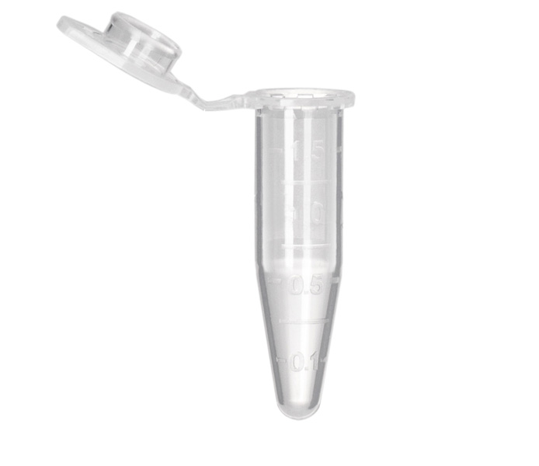
Sanger Sequencing Reactions
Template DNA
Known Primer (~20bp)
DNA Polymerase
Dideoxy Nucleotides
G
A
T
C
Regular Nucleotides
T
C
G
A
C
G
A
T
G
G
A
T
G
T
C
G
A
A
T
A
C
T
G
G
A
T
A
T
G
Labeled
Terminators
T
A
C
C
G
A
C
C
A
T
A
C
G

Slide 12
Sanger Sequencing
Primer
5’
T G C G C G G C C C A
A C G C G C C G G G T ? ? ? ? ? ? ? ? ? ? ? ? ? ? ?
3’
5’

Slide 13
Sanger Sequencing
Primer
5’
G T C T T G G G C T
T G C G C G G C C C A
A C G C G C C G G G T C A G A A C C C G A T C G C G
3’
5’

Slide 14
Sanger Sequencing
Primer
5’
G T C T T G G G C T A G C G C
T G C G C G G C C C A
A C G C G C C G G G T C A G A A C C C G A T C G C G
3’
5’
5’
21 bp
G T C T T G G G C T
T G C G C G G C C C A

Slide 15
Sanger Sequencing
Primer
5’
G T C T T G G G C T A
T G C G C G G C C C A
A C G C G C C G G G T C A G A A C C C G A T C G C G
3’
5’
5’
21 bp
G T C T T G G G C T
T G C G C G G C C C A
5’
26 bp
G T C T T G G G C T A G C G C
T G C G C G G C C C A

Slide 16
Sanger Sequencing
Primer
5’
G
T G C G C G G C C C A
A C G C G C C G G G T C A G A A C C C G A T C G C G
3’
5’
5’
21 bp
G T C T T G G G C T
T G C G C G G C C C A
5’
26 bp
G T C T T G G G C T A G C G C
T G C G C G G C C C A
5’
22 bp
G T C T T G G G C T A
T G C G C G G C C C A

Slide 17
Sanger Sequencing
Primer
5’
G T C T T G G G C
T G C G C G G C C C A
A C G C G C C G G G T C A G A A C C C G A T C G C G
3’
5’
5’
21 bp
G T C T T G G G C T
T G C G C G G C C C A
5’
26 bp
G T C T T G G G C T A G C G C
T G C G C G G C C C A
5’
22 bp
G T C T T G G G C T A
T G C G C G G C C C A
5’
12 bp
G
T G C G C G G C C C A

Slide 18
Sanger Sequencing
Primer
5’
G T C T T
T G C G C G G C C C A
A C G C G C C G G G T C A G A A C C C G A T C G C G
3’
5’
5’
21 bp
G T C T T G G G C T
T G C G C G G C C C A
5’
26 bp
G T C T T G G G C T A G C G C
T G C G C G G C C C A
5’
22 bp
G T C T T G G G C T A
T G C G C G G C C C A
5’
12 bp
G
T G C G C G G C C C A
5’
20 bp
G T C T T G G G C
T G C G C G G C C C A

Slide 19
Sanger Sequencing
A C G C G C C G G G T C A G A A C C C G A T C G C G
3’
5’
5’
21 bp
G T C T T G G G C T
T G C G C G G C C C A
5’
26 bp
G T C T T G G G C T A G C G C
T G C G C G G C C C A
5’
22 bp
G T C T T G G G C T A
T G C G C G G C C C A
5’
12 bp
G
T G C G C G G C C C A
5’
20 bp
G T C T T G G G C
T G C G C G G C C C A
5’
16 bp
G T C T T
T G C G C G G C C C A

Slide 20
Sanger Sequencing
A C G C G C C G G G T ? ? ? ? ? ? ? ? ? ? ? ? ? ? ?
3’
5’
5’
21 bp
? ? ? ? ? ? ? ? ? T
T G C G C G G C C C A
5’
26 bp
? ? ? ? ? ? ? ? ? ? ? ? ? ? C
T G C G C G G C C C A
5’
22 bp
? ? ? ? ? ? ? ? ? ? A
T G C G C G G C C C A
5’
12 bp
G
T G C G C G G C C C A
5’
20 bp
? ? ? ? ? ? ? ? C
T G C G C G G C C C A
5’
16 bp
? ? ? ? T
T G C G C G G C C C A
Notes:
Has to be done in a single tube per rxn.

Slide 21
Sanger Sequencing
Laser Reader
5’
5’
5’
5’
5’
5’
5’
5’
5’
5’
5’
20 bp
21 bp
19 bp
18 bp
13 bp
22 bp
15 bp
16 bp
14 bp
17 bp
G T C T T G G G C
12 bp
T G C G C G G C C C A
G T C T T G G G C T
T G C G C G G C C C A
G T C T T G G G
T G C G C G G C C C A
G T C T T G G
G T C T T G G G C T A
G T C T
T G C G C G G C C C A
T G C G C G G C C C A
G T
G T C T T
G T C T T G
G
T G C G C G G C C C A
T G C G C G G C C C A
T G C G C G G C C C A
T G C G C G G C C C A
T G C G C G G C C C A
T G C G C G G C C C A
G T C

Slide 22
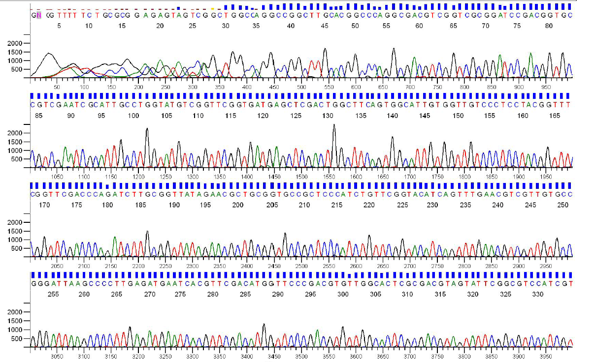
Sanger Sequencing Output
Each sequencing reaction gives us a chromatogram, usually ~600-1000 bp:

Slide 23
Sanger Throughput Limitations
Must have 1 colony picked for every 2 reactions
Must do 1 DNA prep for every 2 reactions
Must have 1 PCR tube for each reaction
Must have 1 gel lane for each reaction
AKA: Must have undergrad/entry-level labor!

Slide 24
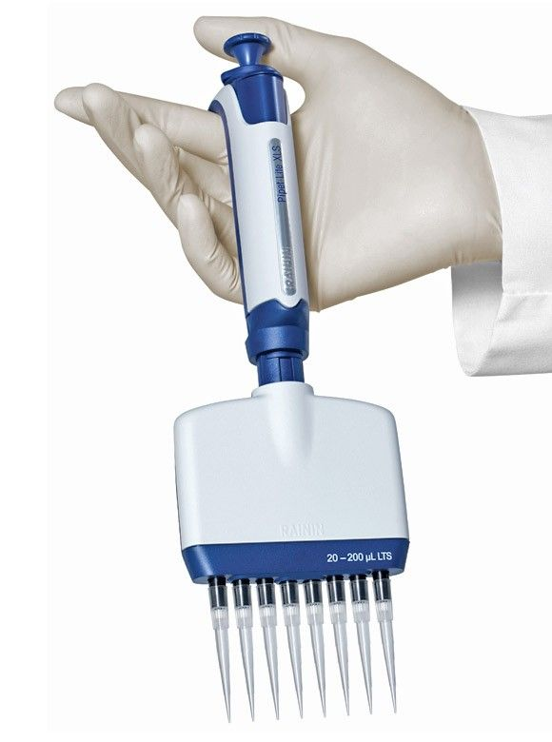
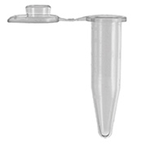
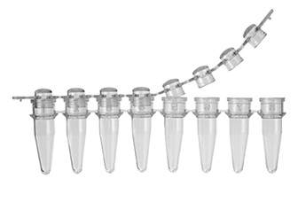

Slide 25
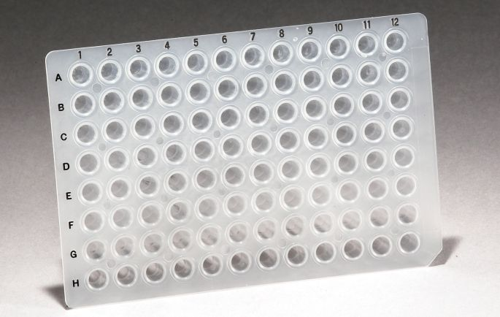
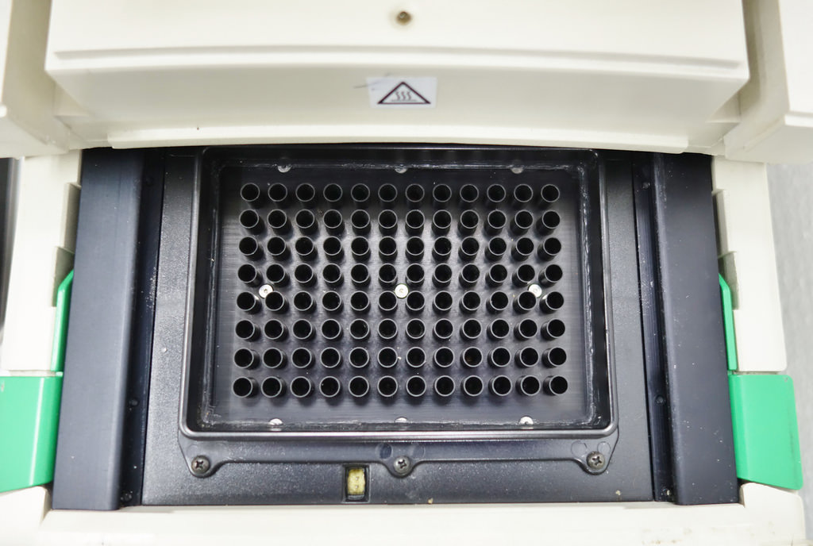
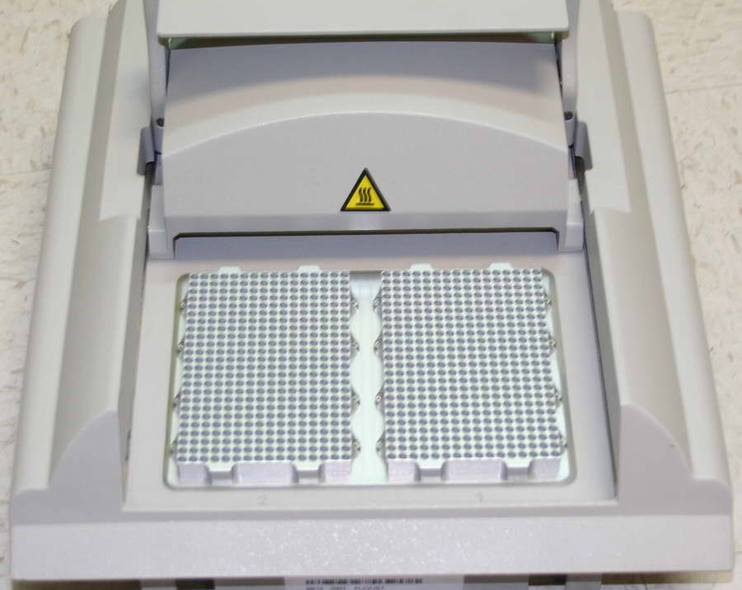
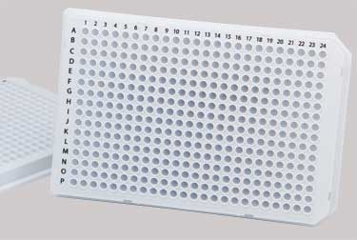

Slide 26

Colony Picking Robot

Slide 27
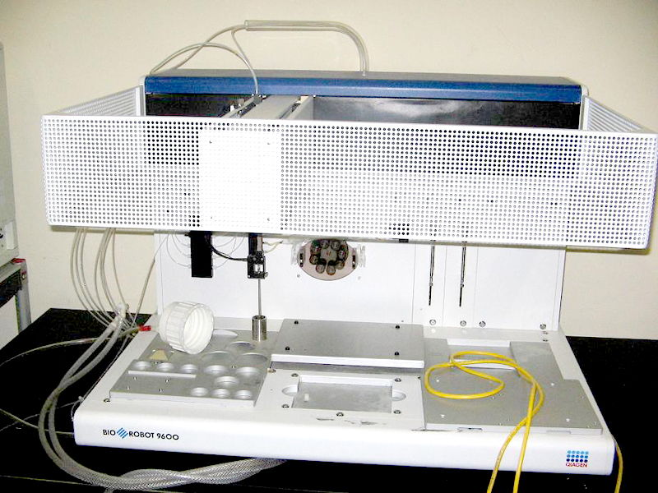

Slide 28
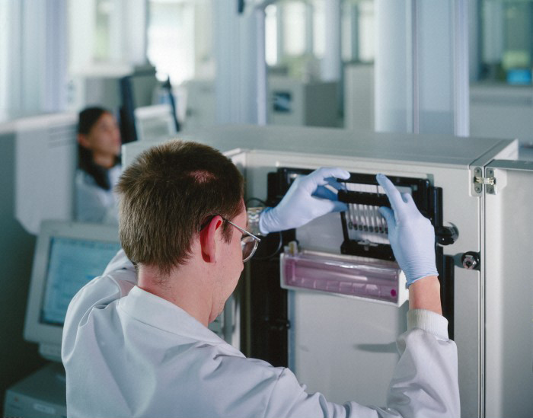

Slide 29
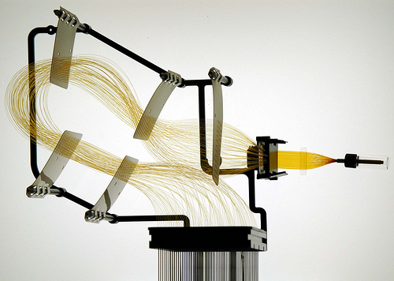
Capillary Arrays

Slide 30
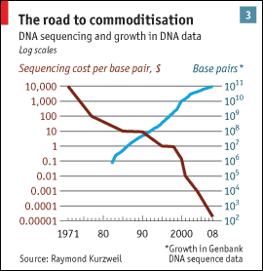
Sanger Throughput Limitations
Must have 1 colony picked for every 2 reactions
Must do 1 DNA prep for every 2 reactions
Must have 1 PCR tube for each reaction
Must have 1 gel lane for each reaction
from The Economist

Slide 31
Problem: How can we do way more reactions at once without having more tubes, thermocyclers, etc.?

Slide 32
Next generation sequencing
Massively parallel

Slide 33
Next generation sequencing

Slide 34
Shotgun sequencing by PGM/454
Genomic
Fragment
Adapters

Slide 35
Next generation sequencing

Slide 36
Shotgun sequencing by PGM/454
Bead/ISP
Adapter
Complement
Sequences
The idea is that each bead should be amplified
all over with a SINGLE library fragment.

Slide 37
Shotgun sequencing by PGM/454
Problem: How do I do PCR to amplify the fragments without having to use 1 tube for each reaction?

Slide 38
Shotgun sequencing by PGM/454

Slide 39
Shotgun sequencing by PGM/454

Slide 40
Shotgun sequencing by PGM/454

Slide 41
Shotgun sequencing by PGM/454
~3.5 µm for Ion Torrent, ~30 µm for 454

Slide 42
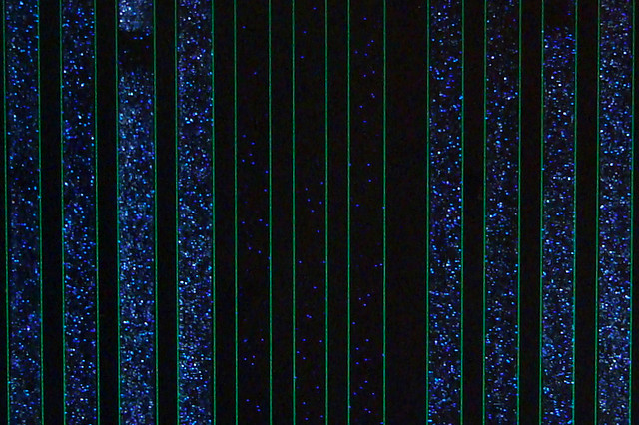
Raw 454 data
Only give polymerase one nucleotide at a time:
G
G
G
Primer
G
G
5’
G
T
T G C G C G G C C C A
C
T T
G G G
A C G C G C C G G G T C A G A A C C C G A T C G C G
3’
5’
If that nucleotide is incorporated, enzymes turn by-products into light:
1 2 3 4 5
The real power of this method is that it can take place in millions of tiny wells in a single plate at once.
T C A G T C A G T C A G

Slide 43
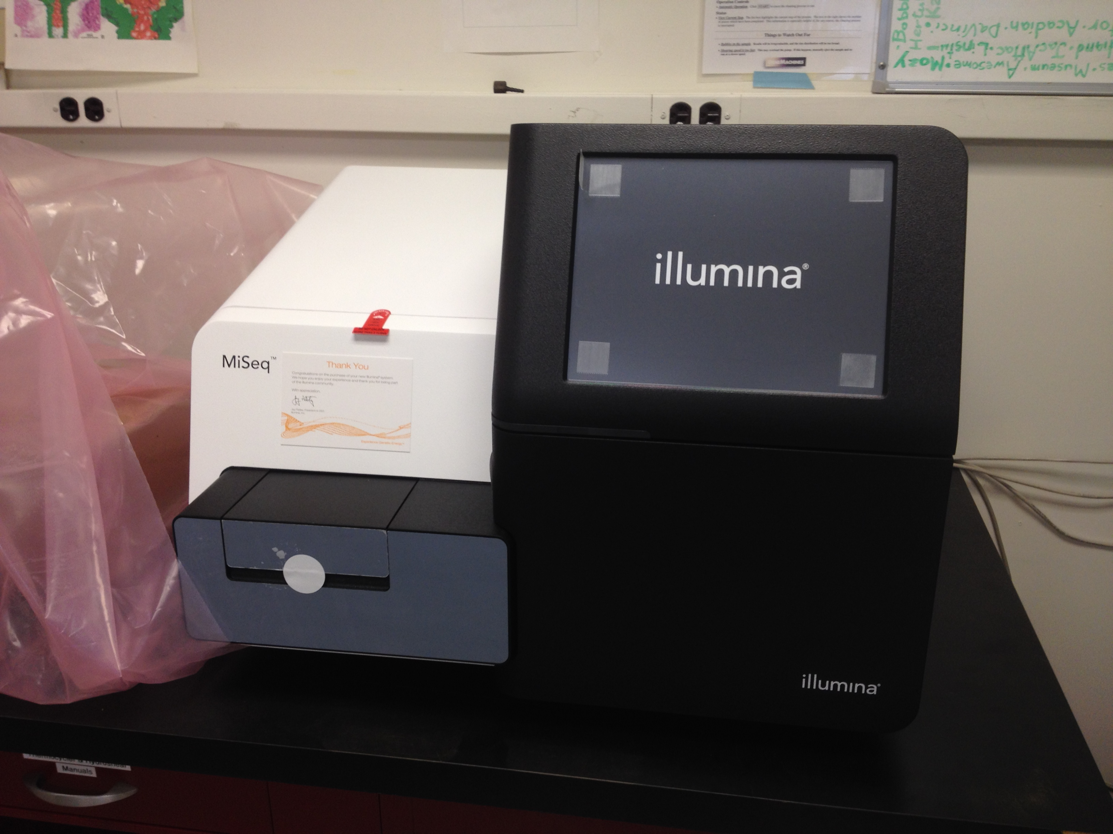
Illumina Sequencing

Slide 44
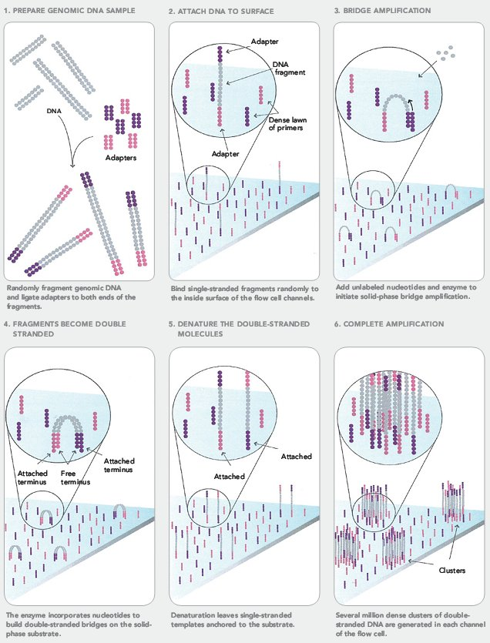
Illumina Sequencing

Slide 45
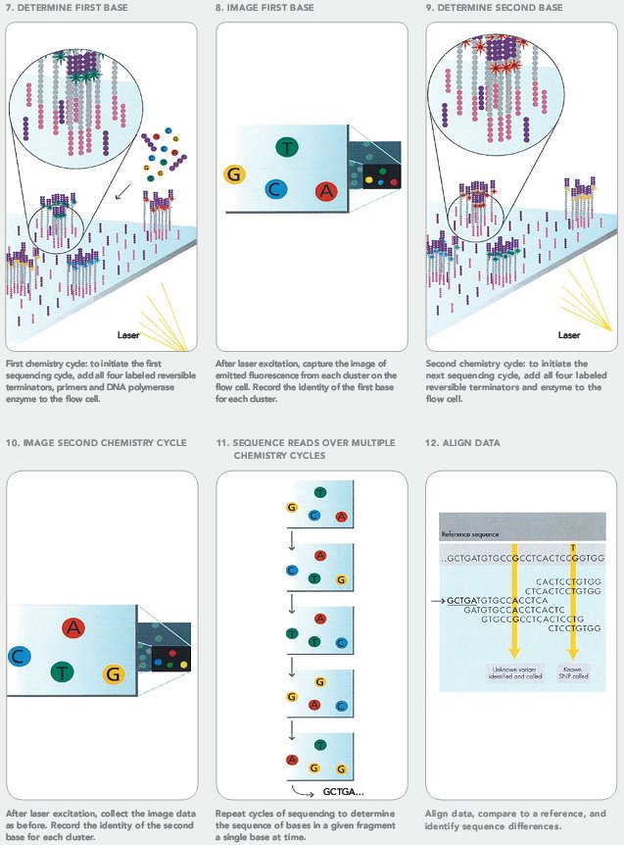
Illumina Sequencing

Slide 46
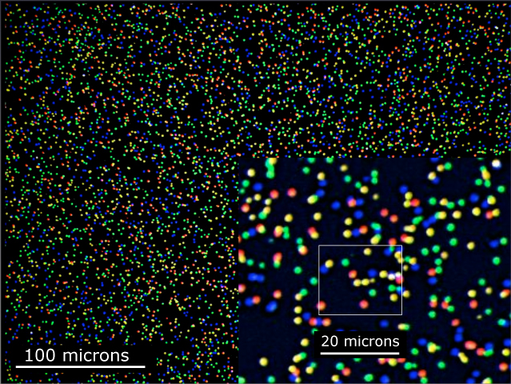
Illumina Sequencing

Slide 47
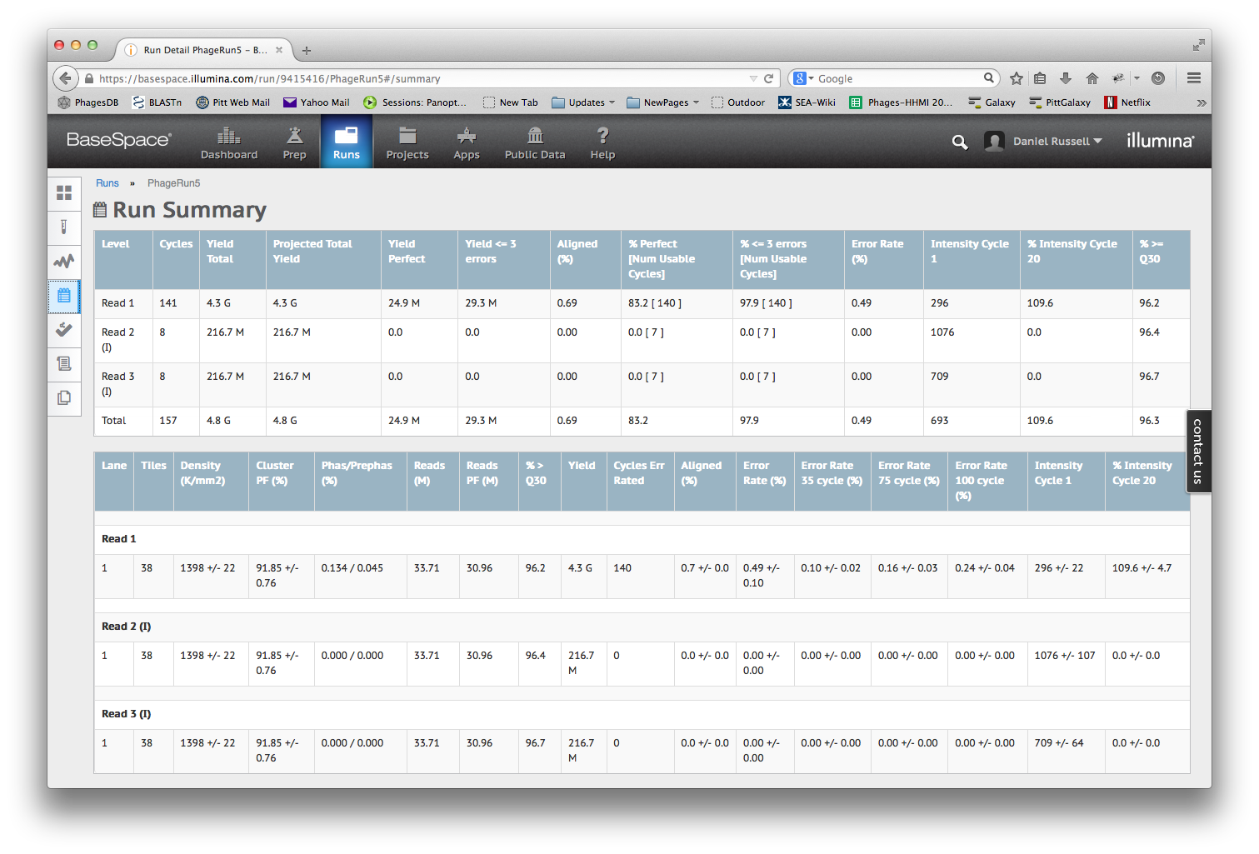

Slide 48
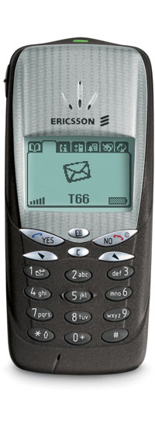
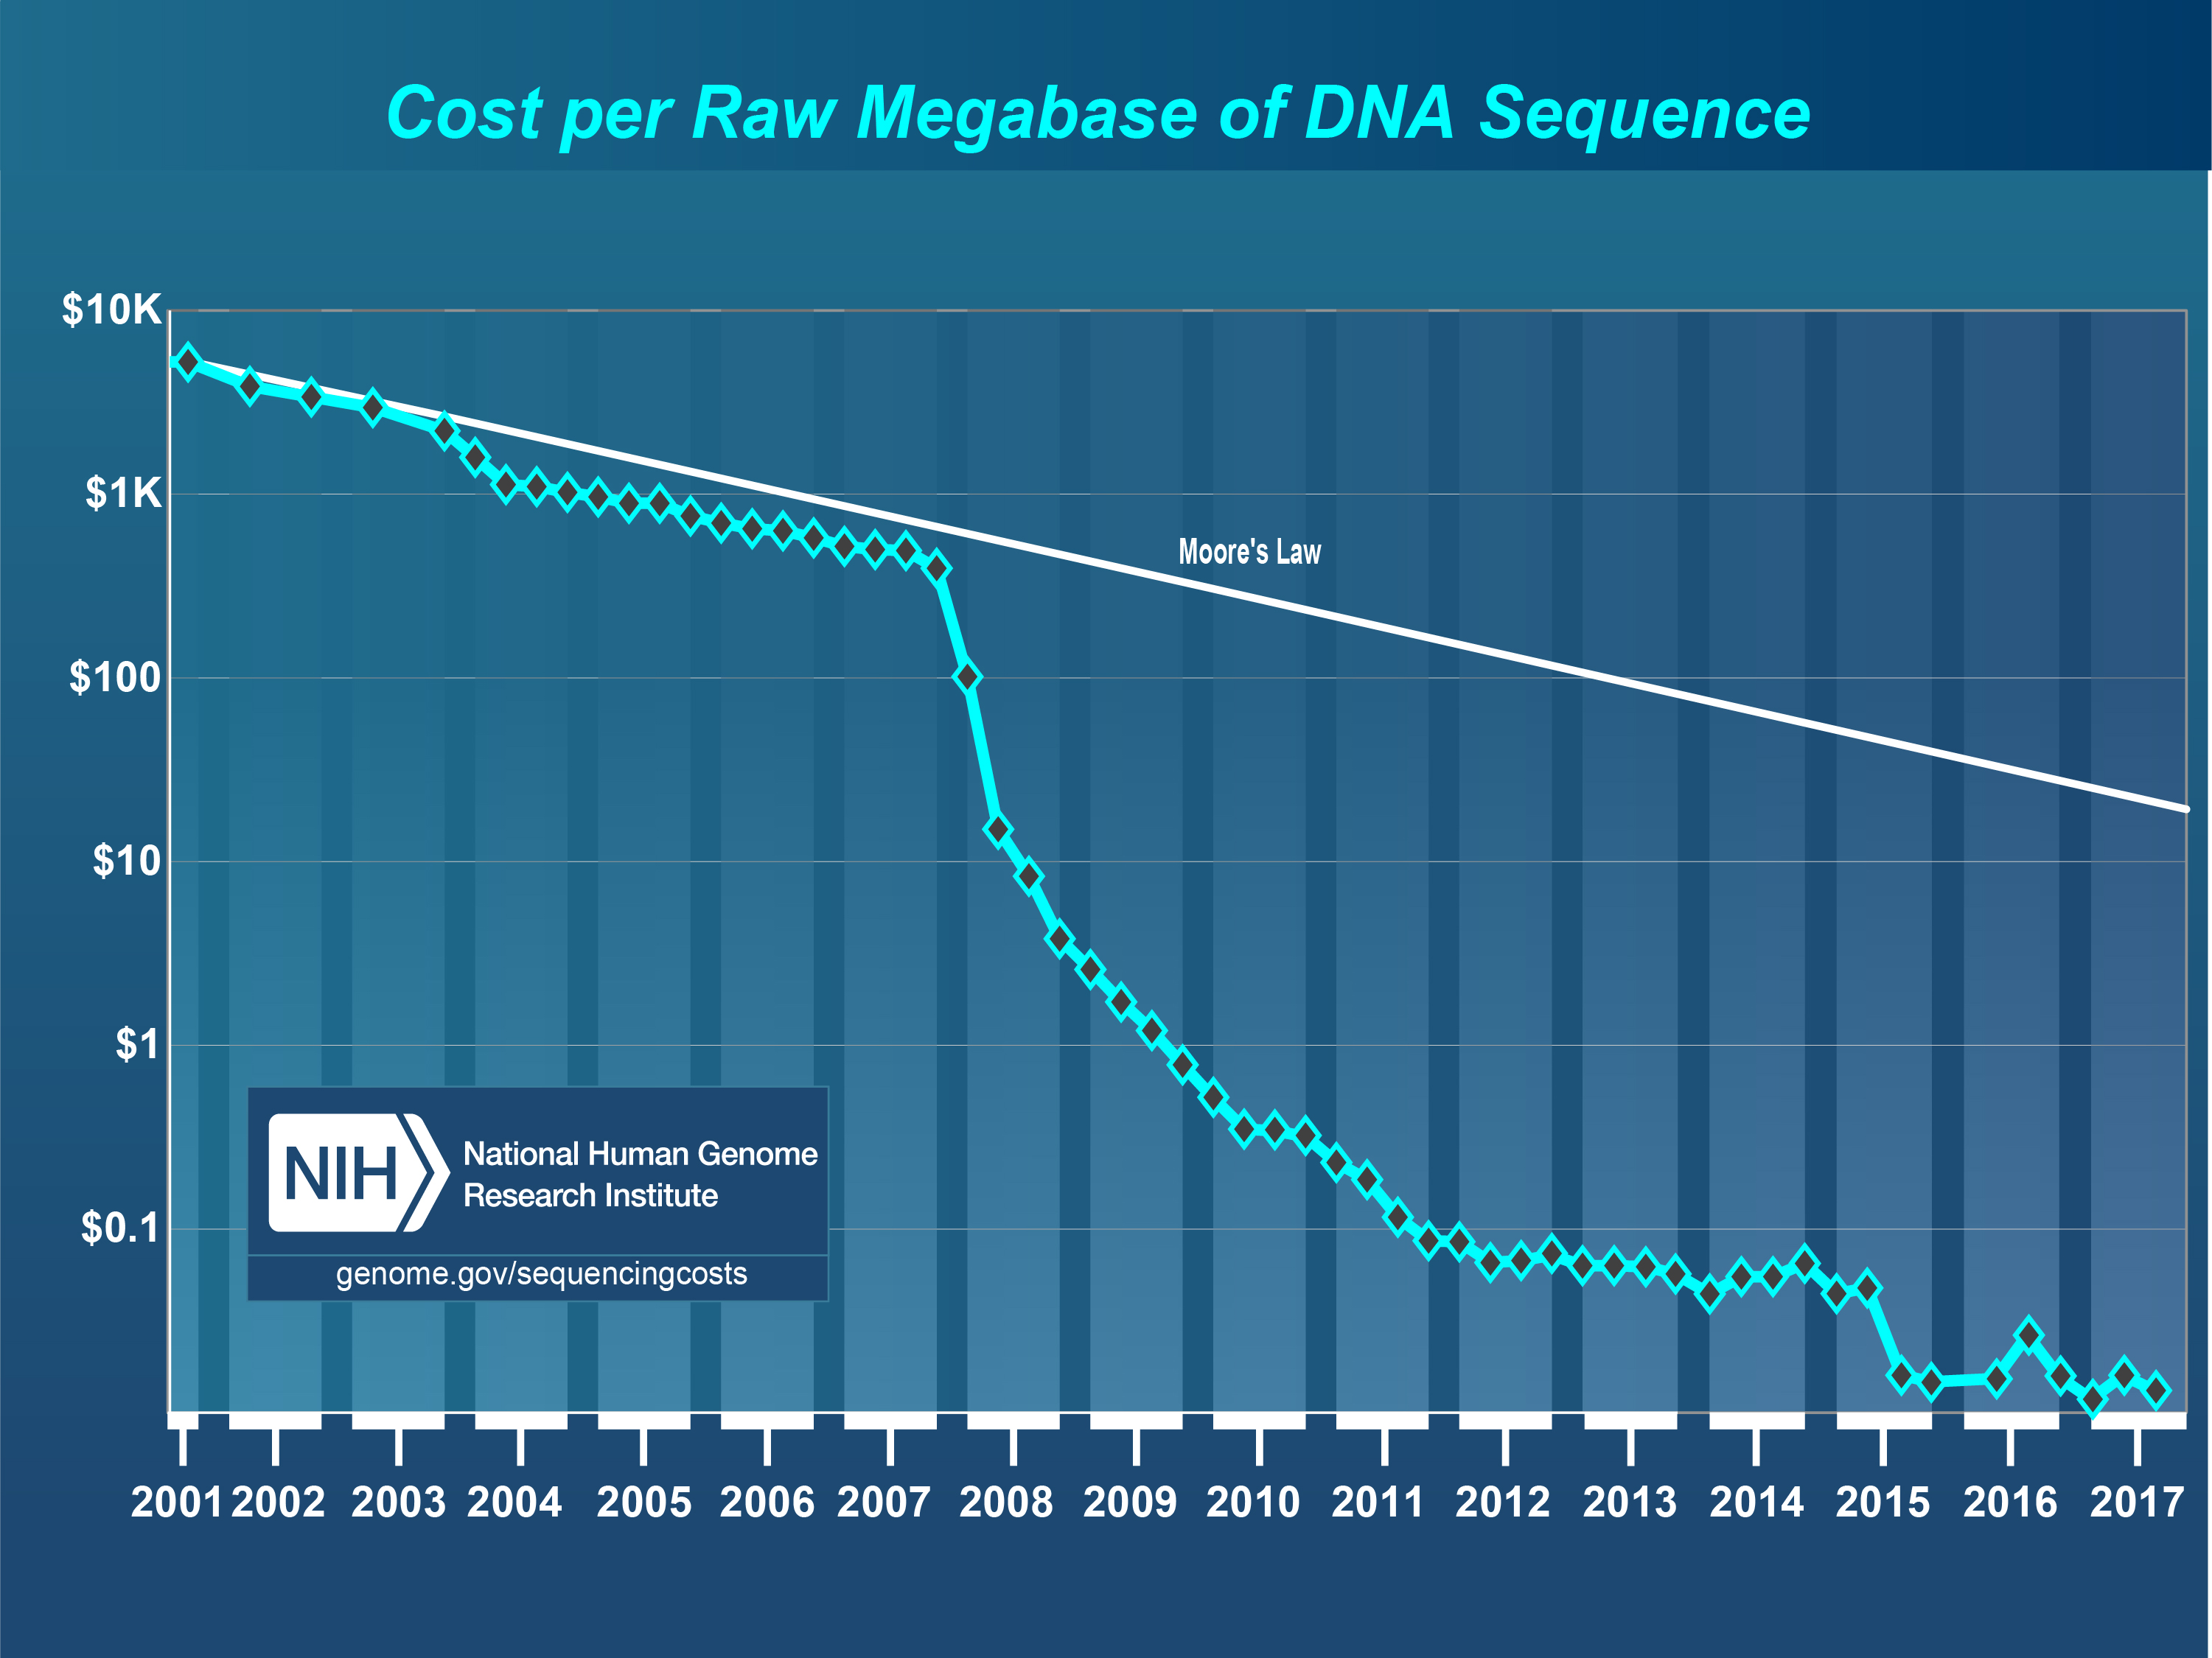
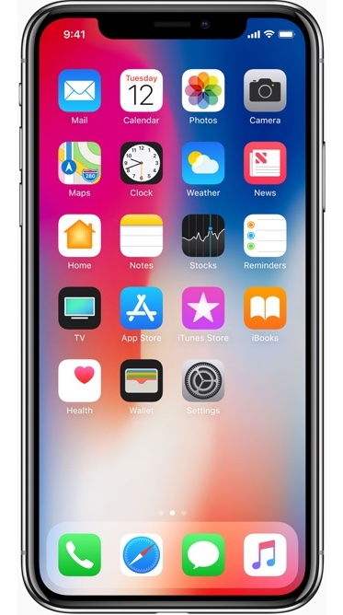

Slide 49
Next-Gen Sequencing
Take home message: Massively Parallel
We’re talking millions or billions of concurrent reads, but without separate tubes

Slide 50
Overview
  Sequencing
  Assembly

Slide 51
Method | Read Length
Sanger | 600-1000 bp
454 | 400-800 bp
Illumina | 75-300 bp
Ion Torrent | ~200 bp
PacBio/Nanopore | ~10,000 bp
But…
Phage Genome: ~5,000 to ~500,000 bp
Bacteria: Several million bp
Human: 3 billion bp

Slide 52
Assembly
17 bp
ATTGTTCCCACAGACCG
CGGCGAAGCATTGTTCC
ACCGTGTTTTCCGACCG
AGCTCGATGCCGGCGAAG
TTGTTCCCACAGACCGTG
TTTCCGACCGAAATGGC
ATGCCGGCGAAGCATTGT
ACAGACCGTGTTTCCCGA
TAATGCGACCTCGATGCC
AAGCATTGTTCCCACAG
TGTTTTCCGACCGAAAT
TGCCGGCGAAGCCTTGT
CCGACCGAAATGGCTCC
66 bp

Slide 53
Assembly
Consensus:
TAATGCGACCTCGATGCCGGCGAAGCATTGTTCCCACAGACCGTGTTTTCCGACCGAAATGGCTCC
ATTGTTCCCACAGACCG
CGGCGAAGCATTGTTCC
ACCGTGTTTTCCGACCG
AGCTCGATGCCGGCGAAG
TTGTTCCCACAGACCGTG
TTTCCGACCGAAATGGC
ATGCCGGCGAAGCATTGT
ACAGACCGTGTTTCCCGA
TAATGCGACCTCGATGCC
AAGCATTGTTCCCACAG
TGTTTTCCGACCGAAAT
TGCCGGCGAAGCCTTGT
CCGACCGAAATGGCTCC

Slide 54

Assembly
Consensus:
TAATGCGACCTCGATGCCGGCGAAGCATTGTTCCCACAGACCGTGTTTTCCGACCGAAATGGCTCC
ATTGTTCCCACAGACCG
CGGCGAAGCATTGTTCC
ACCGTGTTTTCCGACCG
AGCTCGATGCCGGCGAAG
TTGTTCCCACAGACCGTG
TTTCCGACCGAAATGGC
ATGCCGGCGAAGCATTGT
ACAGACCGTGTTTCCCGA
TAATGCGACCTCGATGCC
AAGCATTGTTCCCACAG
TGTTTTCCGACCGAAAT
TGCCGGCGAAGCCTTGT
CCGACCGAAATGGCTCC
Newbler

Slide 55
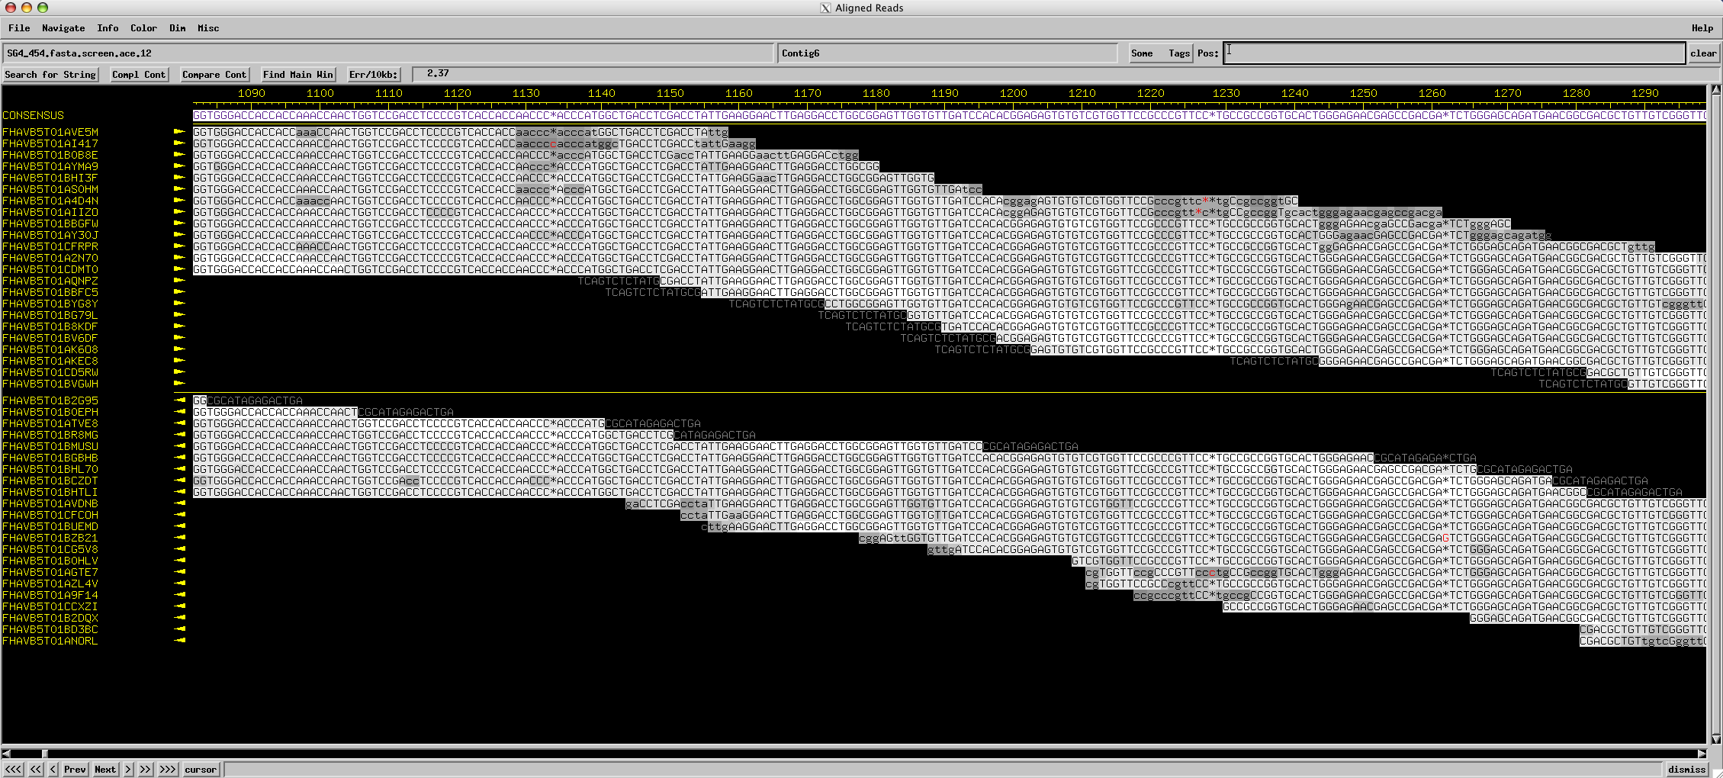
Assembly
Consed

Slide 56
Assembly
Using programs to find overlapping alignments in sequencing reads and build contigs.
The quality of an assembly depends on:
Program used
Type, quality, and length of individual reads
Number of reads used
Complexity of the genome

Slide 57
From 1998 Genome Project Report
“DNA sequencing technology has improved dramatically since the genome project began. The amount of sequence produced each year is increasing steadily; individual centers are now producing tens of millions of base pairs of sequence annually…”

Slide 58
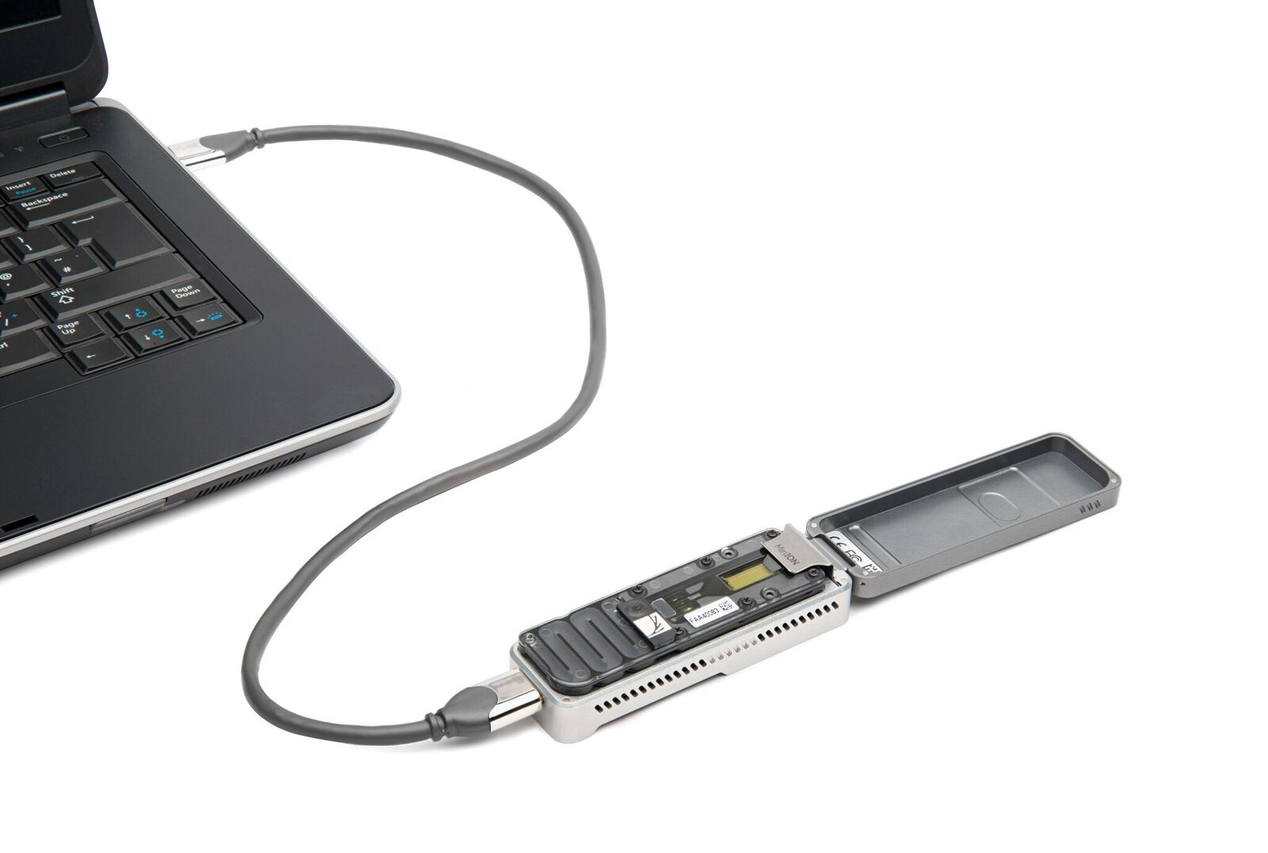

Slide 59
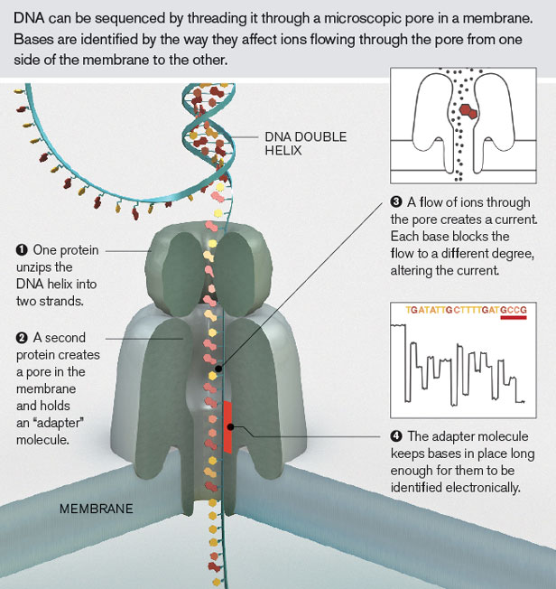
Oxford Nanopore

Slide 60
“The MinION has been used to successfully read … 100,000 base pairs during a single DNA capture, [which] has never been managed before using traditional sequencing techniques.
… but Oxford Nanopore has also introduced GridION [and] the company reckon that a 20-node GridION setup can sequence a complete human genome in just 15 minutes.”
—Wired

Slide 61
Take home
Sequencing getting better faster than computers
Finishing is a prerequisite for annotation
Bioinformatics skills are very marketable

